Slide 1



Welcome 2026 Open Enrollment Medical Coverage July 2026- June 2027
Presented by Blue Cross and Blue Shield of New Mexico

Slide 2
Why Blue Cross and Blue Shield of New Mexico?
DEBB
More Doctors and Hospitals
Coverage Everywhere You Go
Personalized Customer Service
Health and Wellness Programs
Tools and Resources
Digital Capabilities

Slide 3



The strength of BlueSM
NUMBER 1 brand in health care
SHARON ROBERTS
OVER 700K
New Mexicans carry a Blue Card
Serving New Mexicans
Since 1940
Serving the State of New Mexico
employees and families since 2000
98% of claims paid at in-network rates
Notes:
At Blue Cross Blue Shield we make accessing doctors and hospitals a top priority, so our members have access to the best care possible – anytime – anywhere and our national discounts are second to none, so you save money.
BCBS offers you the largest hospital and physician networks in the U.S., with 97% percent of all U.S. hospitals and 83% percent of physicians in network which include Blue Distinction Centers, such as, MD Anderson, Heart Hospital, and the University of New Mexico Cancer Center, to name a few.
BCBSNM in-network discounts and total cost of care are still foundational BCBS strengths. Due to the market-leading breadth of our BlueCard network, more claims are in-network (98%) compared to our competitors (96%) leading to an overall lower cost of care.

Slide 4
HMO – How It Works
Out-of-Network Providers
In-Network Providers
No coverage except for emergency room and urgent care services
Access to contracted HMO, in-network providers in New Mexico
No need to obtain referrals for specialist care
Provider files claims
Predictable copayment
Away from Home Care® Program available in certain states

Slide 5
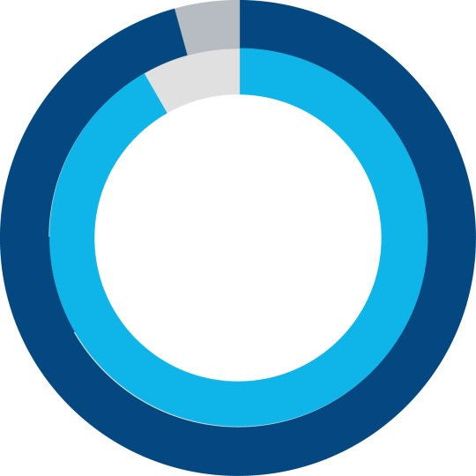







HMO Plan
JEFF K
Over 35,100 HMO-contracted providers in New Mexico including:
BCBS
When traveling outside of New Mexico, you have access to emergency room and urgent care services.
When you or your covered dependents are away from home for more than 90 consecutive days, you will be able to enroll as a Guest Member of an HMO-participating state. Please call to verify participating states.

Slide 6

Away From Home Care Program – HMO
JEFF K
Before enrolling in the BCBSNM HMO Plan
Contact BCBSNM Customer Service and confirm if that particular state participates in the Away From Home Care program.
Please note that not all states participate in this program.
After enrolling
Once you have enrolled in the HMO Plan, a Customer Service Advocate will work with you to complete a Guest Membership application, which is required for the Host HMO to provide you with a membership ID card.

Slide 7
Blue Preferred Plus PPO – How It Works
Out-of-Network Providers
DRAWBACKS
You do have coverage, but
You pay a greater share of the costs
You may receive fewer benefits out-of-network
You may need to file your own claims
You may be billed for charges over the allowed amount (balance billing)
In-Network Providers
ADVANTAGES
Receive the highest level of benefits and potentially pay less for care
Protection from billing over the allowed amounts (balance billing)
No claim forms (provider files claim)
No referrals required
No requirement to select a PCP
Access to a national PPO network

Slide 8
Blue Preferred Plus PPO – 3-Tiered Provider Options
JEFF K
Tier 1 – Blue Preferred PlusSM Providers:
You receive the highest level of benefits when you see a provider in the Blue Cross and Blue Shield of New Mexico (BCBSNM) Blue Preferred Plus Network (Blue Preferred providers are only in the state of New Mexico).
Tier 2 – Preferred PPO Providers:
You receive a higher level of benefits when you see a contracted PPO provider with Blue Cross and Blue Shield anywhere in the U.S.
No balance billing and Provider files claim for you
Tier 3 – Nonpreferred Out-of-Network (OON) Providers:
You receive a lower level of benefits when you see an out-of-network provider.
You will be responsible for paying the provider
You could be balance billed
You are responsible for getting prior authorization, when required

Slide 9
Blue Cross and Blue Shield of New Mexico Blue Preferred Plus PPO Network
JEFF K
The Blue Preferred network (Tier 1) includes a variety of doctors, hospitals and other health care providers throughout New Mexico that can meet your health care needs.
With the Blue Preferred Plus plan, you will get the highest level of benefits when you visit the providers in the Blue Preferred network. You will still have the option of choosing a provider from the larger, statewide PPO network (Tier 2), but you will pay higher out-of-pocket costs than with the Blue Preferred network.
Over 30,200 (Tier 2) contracted providers in New Mexico including:

Slide 10
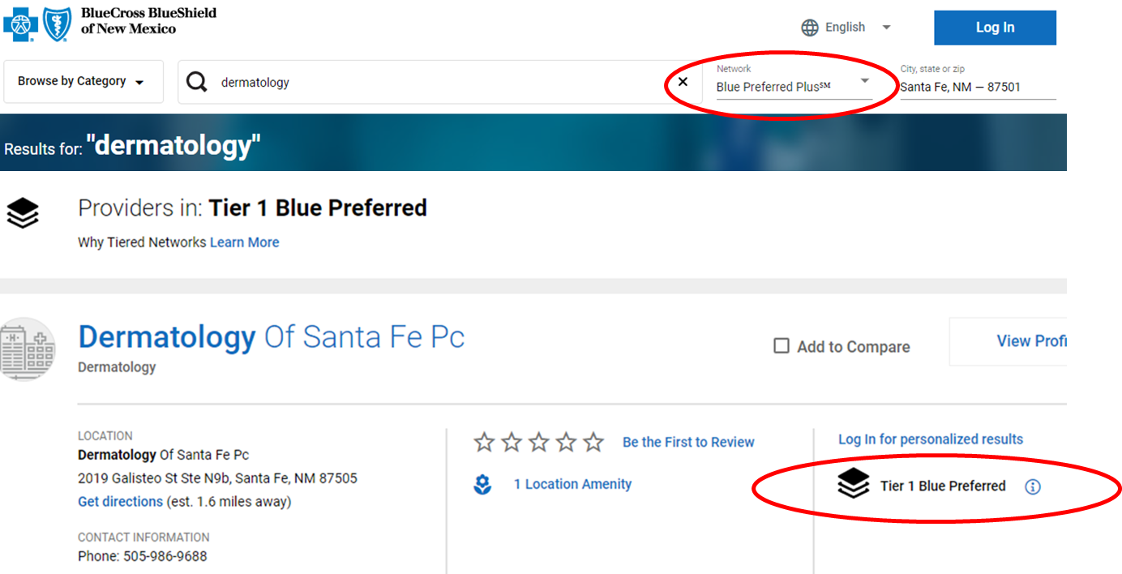
How To Find a PPO Tier 1 or Tier 2 Provider
JEFF K
Search under the Blue Preferred Plus Network (Tier 1) or the Preferred Provider Organization Network (PPO) (Tier 2)
Look for the Tier 1 indicator next to the provider entry

Slide 11

Prior Authorization
LISA
Prior authorization is a process used to determine whether a medical service meets the requirements for health plan coverage.
You need to have prior authorization for some types of medical care such as:
Hospital stays
High-cost specialty drugs
Some services you get outside a hospital
Your network provider will usually take care of prior authorization. To be sure, call Customer Service before your service.
Check your benefits booklet to learn more. You can find it on Blue Access for Members^{sm}

Slide 12

Preventive Coverage
DEBB
What’s Covered?
Recommended routine gender- and age-specific preventive care and screenings — including yearly general wellness exams, recommended vaccines and screenings for things like diabetes, cancer and depression — both facility and professional services.
Coverage provided in-network at 100% with no copay, no deductible. Out-of-network benefits may vary.
IMPORTANT to remember: Lab tests related to a condition such as diabetes or asthma are not considered preventive and are covered under applicable deductible and coinsurance levels.
Stay healthy by getting regular check-ups
Notes:
Approved 06/30/25
EMI Team – Deborah Wells, Debb Bastian
Content approved by Jennifer Fiske, Chris Segura
IMPORTANT to remember: Lab tests related to an illness or condition – such as diabetes or asthma – are not considered preventive and are covered under applicable deductible and coinsurance levels. Because these tests feel “routine” to the member, this can cause confusion.
Non-grandfathered health plans are required by the Affordable Care Act to provide coverage for preventive care services without cost-sharing only when the member uses a network provider. You may have to pay all or part of the cost of preventive care if your health plan is grandfathered.
To find out if your plan is grandfathered or non-grandfathered, call the Customer Service number listed on your member ID card.
2025 Preventive Services Member Flier, access from: https://myfyi.sharepoint.com/sites/hub-opscomms/SitePages/Preventive-Services.aspx

Slide 13

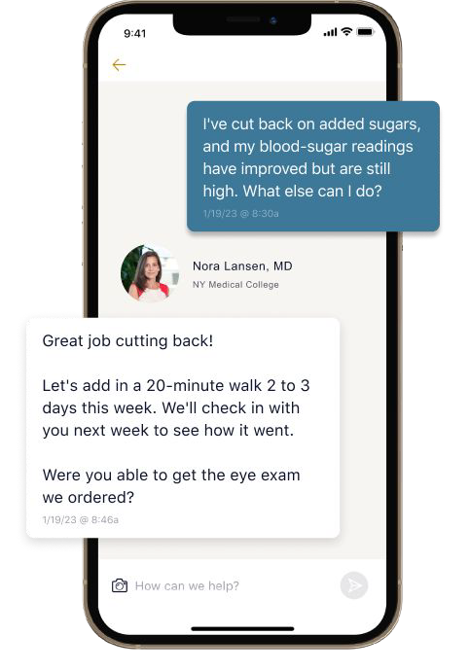
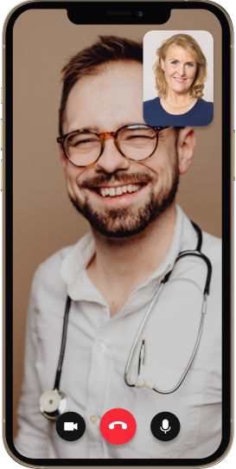
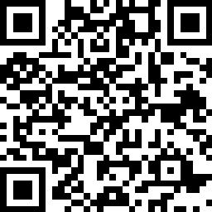

High-Quality Primary Care That’s Always Available
Galileo is in-network for
Blue Cross and Blue Shield of New Mexico Members
How Galileo Works
Connect with real doctors anytime via video or chat on the Galileo app (available in English & Spanish).
Get care for almost any health concern, from everyday issues like acne and colds to ongoing conditions like anxiety and diabetes.
Prioritize your health with an annual wellness visit over video.
Feel heard, not rushed. Galileo providers take their time and listen to your questions and concerns.
Enroll Now:
Scan the QR code with your phone camera
or visit: galileo.health/bcbsnm
Need help?
Call: (855) 648-8859
Email: support@galileohealth.com
Notes:
In 2026 get High-quality primary care that’s always available through Galileo
As you know, providing our members with the best healthcare options is top priority. We understand the importance of convenience, accessibility, and quality of care. Our virtual primary care services provided by Galileo offers a range of benefits.
Convenience and Accessibility: Member can consult with a primary care physician from the comfort of their homes, or work. Reducing the need for travel and wait times for an in-person appointment.
Comprehensive Care: Virtual primary care includes routine check-ups, chronic conditions management, prescription refills, and more.
24/7 Availability: Access to healthcare professionals around the clock ensures your clients receive timely medical advice and support.
How Galileo Works
Galileo is in-network with Blue Cross and Blue Shield of New Mexico
• Connect with real doctors anytime via video or chat on the Galileo app (available in English & Spanish).
• Get care for almost any health concern, from everyday issues like acne and colds to ongoing conditions like anxiety and diabetes.
• Prioritize your health with an annual wellness visit over video.
• Feel heard, not rushed. Galileo providers take their time and listen to your questions and concerns.
This provider option is a powerful addition to the services provided to our members. Virtual primary care gives members an opportunity to access additional providers for services.
Employer Groups and their Eligible Members can learn more about Galileo and create their account to get started at galileo.health/bcbsnm or call (855) 648-8859 or Email: support@galileohealth.com

Slide 14

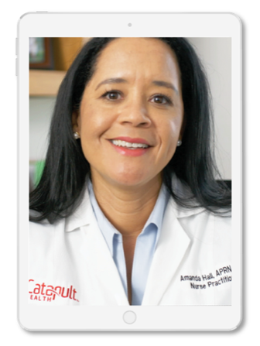



What’s in it for participants?
Virtual Video Consult
with a Board-Certified
Nurse Practitioner
ACCESSIBLE
CONVENIENT
SAFE
EMPOWERING
VirtualCheckup® By Request
Testing results discussed & Personal Action Plan created
Referral into optimal health improvement programs
VirtualCheckup® Onsite
Results transmitted to participant’s PCP, same day and at no charge
Follow-up touch points with high-risk participants
Notes:
Both services provide a safe, fast and convenient option that serves as an alternative to a normal doctor visit, especially to those who may not have a primary care physician or may be experiencing a lapse in treatment.
Our services may allow participants to receive medical counsel at an expedited pace considering that choosing an in-network physician, as well as scheduling an appointment can be an arduous task at times.
The virtual consultation can be done in the comfort of your own home, skipping reception at the doctor's office as well as lengthy wait times.
NP’s will explain your Blood Panel Results and discuss a Personalized Action Plan tailored to your health.
Referrals into health improvement programs may be recommended based off findings and results are sent to each participant's smartphone and to their PCP if the
Those without a PCP will be assisted in finding one for preventative and continued care.

Slide 15


Get Care When and Where You Need It
JEFF K
Whether you’re at home or traveling, access to an independently contracted, board-certified doctor is available 24/7.
You can speak to an MDLIVE® doctor immediately or schedule an appointment for a time that works for you.
MDLIVE doctors can help treat many non-emergency conditions.
A Virtual Visit may be a better alternative to the emergency room or urgent care center.
Virtual Visits may be limited by plan. For providers licensed in New Mexico and the District of Columbia, Urgent Care service is limited to interactive online video; Behavioral Health service requires video for the initial visit but may use video or audio for follow-up visits, based on the provider’s clinical judgment. Behavioral Health is not available on all plans. MDLIVE is a separate company that operates and administers Virtual Visits for Blue Cross and Blue Shield of New Mexico. MDLIVE is solely responsible for its operations and for those of its contracted providers. MDLIVE and the MDLIVE logo are registered trademarks of MDLIVE, Inc., and may not be used without permission.
Notes:
Under your plan, Get cost-effective, 24/7 Care with Virtual Visits powered by MDLive.
With Virtual Visits from MDLive, the doctor is always in. Skip expensive ER Bills and waiting to see a doctor. You can speak with a Virtual Visits doctor within minutes. This Blue Cross and Blue Shield of New Mexico benefit gives you access to 24/7 non-emergency care from a board-certified doctor or therapist by phone, online video or mobile app –no matter where you live. Services are available in both English and Spanish with translation services available in other languages.
This digitally based solution saves you time and provides you with cost effective health care any time any place. When appropriate, prescriptions can be sent instantly to the member’s pharmacy of choice. So, remember the next time you or a covered family member isn’t feeling well, with Virtual Visits you have 24/7 access to get care the convenient way in the comfort of your home!

Slide 16

Mental Health Hub
Expanded Access to Innovative Treatment and Solutions for:
Substance Use Disorders
Pediatric Mental Illness
Eating Disorders
Obsessive Compulsive Disorders
Mental Health Hub offers:
Digital, one-stop-shop for mental health resources
Direct access from bcbsnm.com
Wellness check-in to assess your mental health needs
Personalized recommendations
Condition-specific articles, videos, podcasts, tools and more
The Mental Health Hub is administered by NovaWell. NovaWell is an independent company that has contracted with Blue Cross and Blue Shield of New Mexico to provide member health platform and tools, mental health administration network and health information content for members with coverage through BCBSNM. BCBSNM makes no endorsement, representations or warranties regarding third-party vendors and the products and services offered by them.
Notes:
Approved 07/25/25
EMI Team – Deborah Wells, Debb Bastian
Content approved by Vani Vinay, Shawna Lewis, Jessica Doyle, Chris Segura
Integration: To give you an integrated, seamless experience, BCBSNM has created a digital, one-stop-shop where all behavioral health (BH) providers, vendors and BH resources can be found.
Navigation: Within this platform, you will have access to a comprehensive self-assessment where you indicate the mental health symptoms you’re experiencing and the corresponding severity level of those symptoms.
Personalization: After taking the assessment, you will receive a recommended list of solutions tailored to your needs, including potential providers (therapists and psychiatrists) and/or self-led digital tools available through your plan benefits.
Access: The platform also offers access to existing and new specialty BH providers who offer innovative, evidence-based treatment for distinct behavioral health conditions and/or populations, including substance use disorders, pediatric mental illness, eating disorders, obsessive-compulsive disorders and more.
You will be able to connect to the right solution earlier in your treatment journey, have greater access to specialty BH providers and receive care faster.

Slide 17

Digital Mental Health Delivered by
GET STARTED WITH A MENTAL HEALTH ASSESSMENT:
Go to bcbsnm.com/sonm
Log in to Blue Access for MembersSM
Choose My Health then Wellness, then find Digital Mental Health
Online programs and services based on proven therapy techniques (English and Spanish); personal coaching is also available by phone, text or email
Private, convenient way to get help for mental health concerns:
Depression
Insomnia
Panic
Resilience
Stress, Anxiety and Worry
Social Anxiety
Substance Use
Available to employees and family members (13 and older) at no cost to you
Less than 50% of people with a mental health condition receive treatment*
*National Alliance on Mental Illness, Mental Health by the Numbers, 2019
Learn to Live provides educational behavioral health programs. Members considering further medical treatment should consult with a physician. Learn to Live, Inc. is an independent company that provides online behavioral health programs and tools for members with coverage through Blue Cross and Blue Shield of New Mexico.
BCBSNM makes no endorsement, representations or warranties regarding third-party vendors and the products and services offered by them.
Notes:
Approved 07/25/25
EMI Team – Deborah Wells, Debb Bastian
Content approved by Vani Vinay, Shawna Lewis, Jessica Doyle, Chris Segura
Why digital mental health?
Millions in the U.S. with mental health disorders never pursue in-person therapy.
Several factors can contribute:
They may not have access to providers nearby.
Cost may be a factor.
There is a time, knowledge and effort investment in finding the right type of provider, making the appointment, traveling, taking time away from work or personal responsibilities.
They may be reluctant to get help because of negative attitudes or beliefs about people with mental health issues.
Or they may not be aware of the benefits of therapy.
An online CBT tool can make it easier for members who would like to improve their mental health, have never received mental health treatment to start that journey, or act as a supplement to in-person treatment.
Our digital mental health platform, powered by the vendor Learn to Live, has programs for:
Depression
Insomnia
Panic
Resilience
Stress, Anxiety and Worry
Social Anxiety
Substance Use

Slide 18

Cancer Services and Support
DEBB
A cancer diagnosis can change your life forever. We are here to help.
The Cancer Services and Support program will give you the tools, resources and expert advice to help you before, during and after cancer treatment.
Cancer Support: Our skilled cancer care nurses are on hand to help you prepare for doctor office visits, share treatment information or give emotional support — wherever you are in your cancer journey.
Expert Review and Support: If you are actively undergoing treatment or a cancer survivor, you can ask that a medical expert review your case. This allows you to get expert recommendations and clinical trial matches while staying close to home.
Cancer care nurse support is available today by calling the number on the back of your ID card.
Notes:
Approved 06/23/25
EMI Team – Deborah Wells, Debb Bastian
Content approved by Morgan Ferrell, Jessica Brewer, Sarah Brown

Slide 19

Online Tools

Slide 20
Blue Access for MembersSM
SERINA CHRIS
Through BAMSM, you can:
Once registered, view, print or download your member ID card
View claims status and history
See health care benefit information
Find a doctor or pharmacy near you
Update your communication preferences to go paperless
Log in and perform protected transactions 24 hours a day, 7 days a week*
Save time with self-service support tools and health and wellness resources available through a convenient and secure website
*Claim Statements/EOBs are not available 3 – 6 a.m.
Notes:
Approved 06/18/24
EMI Team – Deborah Wells, Debb Bastian
Content approved by Serina Solomon and Eamon Madigan
Blue Access for Members
You can save time using self-service support tools, including the following and more:
Check the status of a claim; view and print Explanation of Benefits (EOBs)
View, print or download member ID cards
Confirm who is covered under the plan
Check plan coverage details and Rx benefit information
Secure access – employers can log in to their accounts and perform protected transactions 24 Hours a day, 7 days a week* [*Claim Statements/EOBs are not available 3-6 a.m.]
NOTE:
Blue Access for Members is available to all members. Options available within the portal will vary depending on group membership and benefit selections.

Slide 21
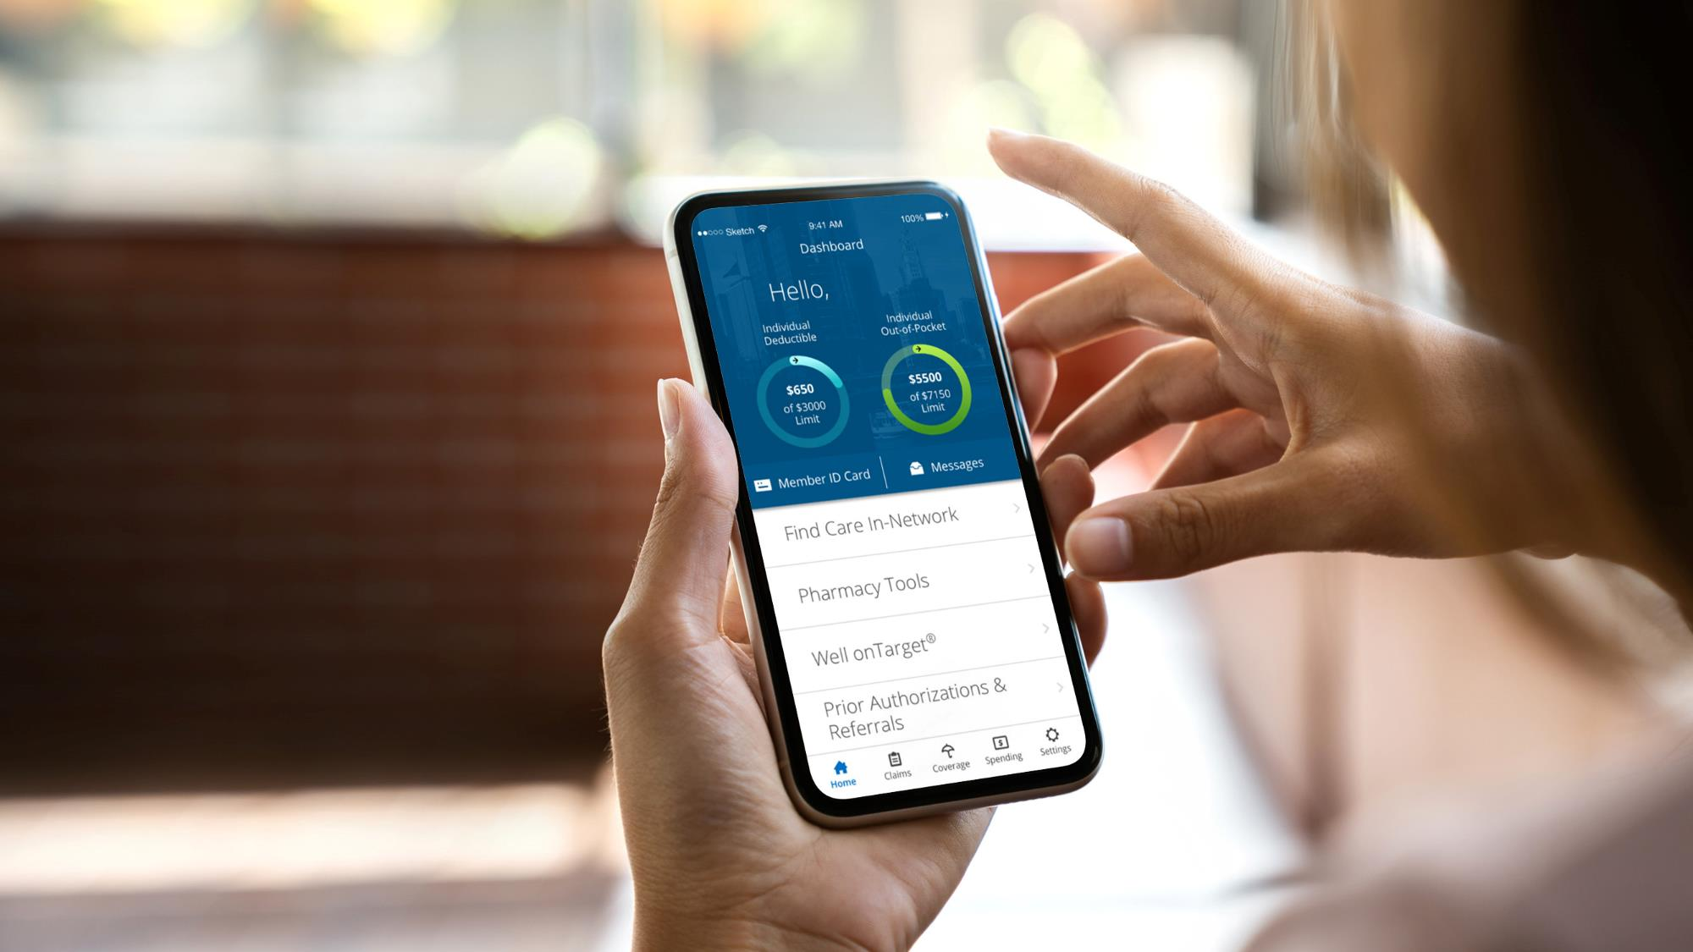

MOBILE APP
With the BCBSNM App, you can manage your health care information whenever, wherever
To download, text
BCBSNMAPP
to 33633

Slide 22

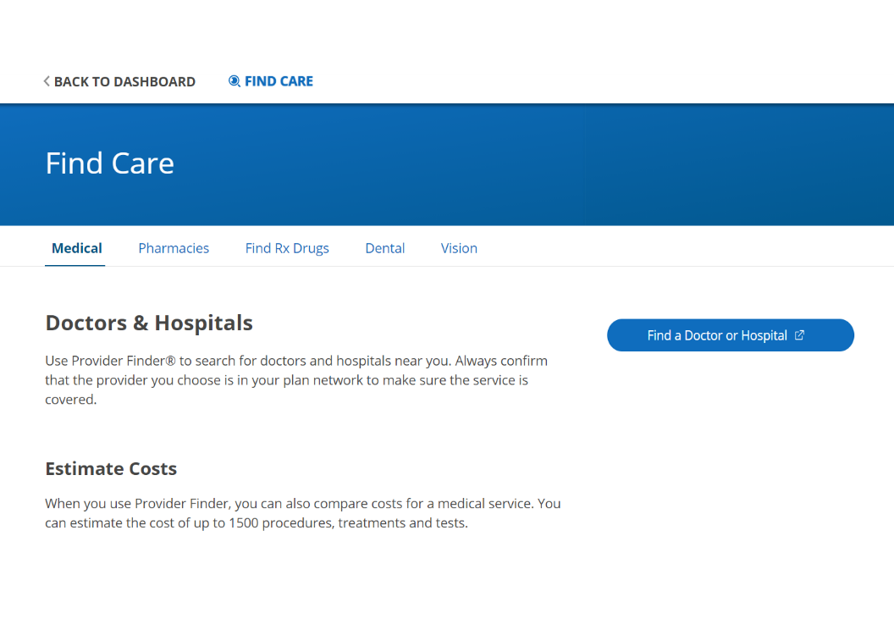
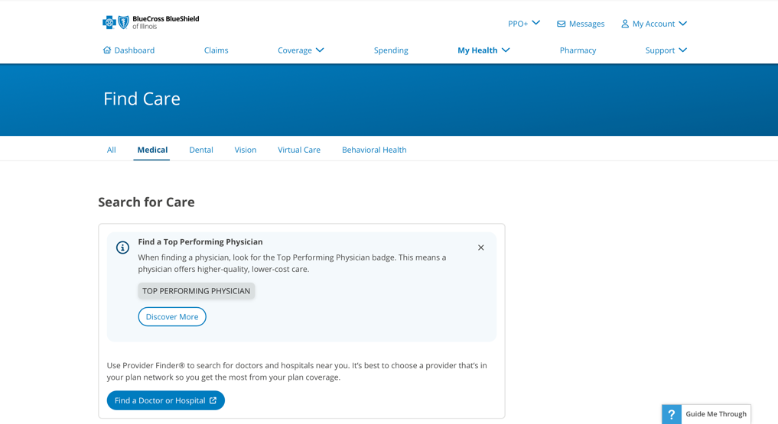

How to Access Provider Finder®
Click on Find a Doctor or Hospital
Notes:
Approved 07/01/25
EMI Team – Deborah Wells, Debb Bastian
Content approved by Kyle Desembrana

Slide 23
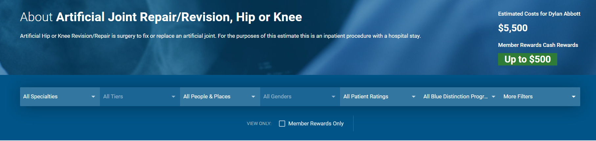
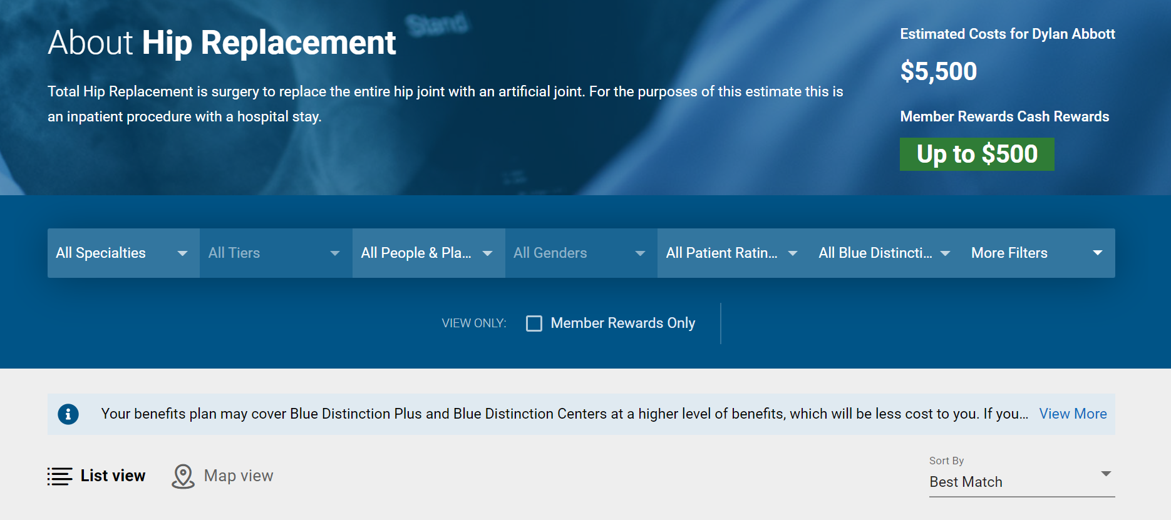

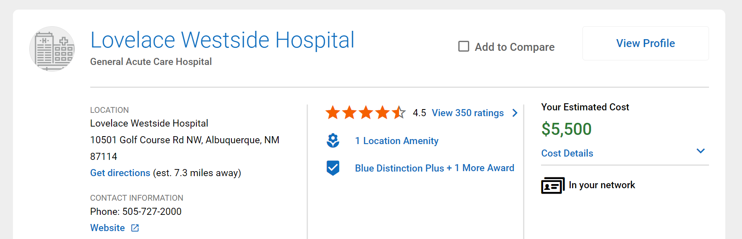
Cost Estimate Search Results
Did you know?
Cost Range for a Knee Replacement
Description of procedure or service
Albuquerque, NM
$18,879 – $46,153
Compare up to four search results
View full cost breakout of the procedure

Slide 24

Health and Wellness
JESSICA

Slide 25
Your Health and Wellbeing Programs
FIT BETTER HEALTH INTO YOUR SCHEDULE
Well onTarget® helps you reach your health and wellness goals through online self-management programs and rewards.
Digital Mental Health supports your mental wellbeing with programs for stress, depression, sleep problems, panic and substance use.
24/7 Nurseline conveniently answers your health questions.
Fitness Program gives you access to a network of gyms that fit your budget and lifestyle.
Digital coaching programs help you manage your weight, diabetes, high blood pressure and joint and spine issues.
LISA M
SAMI H
Log in at bcbsnm.com to access these resources and more.
Notes:
Approved 06/25/25
EMI Team – Deborah Wells, Debb Bastian
Content approved Clara Henao, Margaux Shain, Samantha Hamilton
Your new health benefits include tools that can help you get healthier how and when it works for you.
Through Blue Access for Members‭‭, you can access ‭resources to help you manage your health conditions, get ‭answers to health questions and reach your wellness goals.
For quick access to all your health and wellness resources:
Go to bcbsnm.com.
Sign up for or log in to Blue Access for MembersSM.
‭========================
Well onTarget is a voluntary wellness program. Completion of the Health Assessment is not required for participation in the program.‭
Blue Points‭ Program Rules are subject to change without prior notice. See the Program Rules on the Well onTarget Member Wellness Portal at wellontarget.com for further information. Member agrees to comply with all applicable federal, state and local laws, including making all disclosures and paying all taxes with respect to their receipt of any reward.‭
An enrollment fee and monthly fee apply per member (subject to change). Taxes may apply. Individuals must be 18 years old to purchase a membership. Dependents, 16-17 years old, can join but must be accompanied to the location by a parent/guardian who is also a Fitness Program member. Check your preferred location to see their membership age policy. Underage dependents can login and join through the primary member’s account as an “additional member.” The Fitness Program is provided by Tivity HealthTM, an independent contractor that administers the Prime Network of fitness locations. The Prime Network is made up of independently owned and operated fitness locations.
‭24/7 Nurseline is not available to IL HMO members. For medical emergencies, call 911. This program is not a substitute for a doctor’s care. Talk to your doctor about any health questions or concerns.

Slide 26
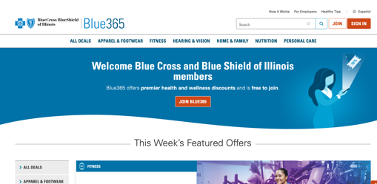
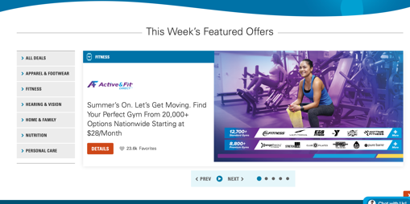

Blue365® Member Discount Program
JESSICA
Member discounts simply for being a BCBSNM member
Exclusive health and wellness deals from national and local retailers
Save money on fitness classes and gear, family activities, healthy eating, dental, vision, hearing aids and more from top national and local retailers
Go to www.blue365deals.com/bcbsnm to register, view your available discounts and sign up for weekly emails
Welcome Blue Cross and Blue Shield of New Mexico members
The relationship between these vendors and Blue Cross and Blue Shield of New Mexico is that of independent contractors. Blue365 is a discount program only for BCBSNM members. This is NOT insurance. Some of the services offered through this program may be covered under your health plan. Employees should check their benefit booklet or call the Customer Service number on the back of their ID card for specific benefit facts. Use of Blue365 does not change monthly payments, nor do costs of the services or products count toward any maximums and/or plan deductibles. Discounts are only given through vendors that take part in this program and are subject to change. BCBSNM does not guarantee or make any claims or recommendations about the program’s services or products. Members should consult their doctor before using these services and products. BCBSNM reserves the right to stop or change this program at any time without notice. BCBSNM makes no endorsement, representations or warranties regarding third-party vendors and the products and services offered by them.
Screen images are for illustrative purposes only.
Notes:
Approved 06/17/25
EMI Team – Deborah Wells, Debb Bastian
Content approved by Cora Weisenberger
Blue365 member discount program. Simply for being a Blue Cross and Blue Shield of New Mexico member, you will be able to receive exclusive health and wellness deals from national and local retailers to help keep you healthy. Save money on health care products and services that are not always covered by your benefit plan such as fitness classes, vision exams and services, hearing aids, fitness devices and diet-related services.
Log on to Blue Access for Members and under Member Services you'll find information about the discount program. From your BAM home page, you can access the Blue 365 Member Discount Program from the Wellness menu (under My Health).

Slide 27
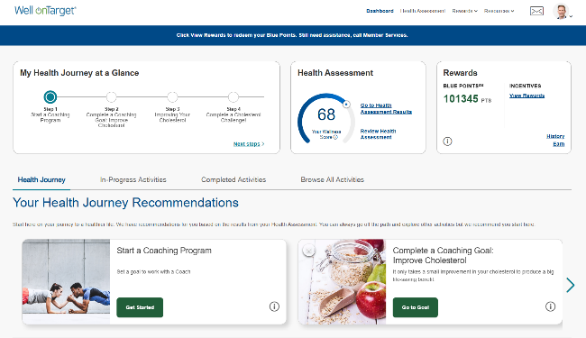
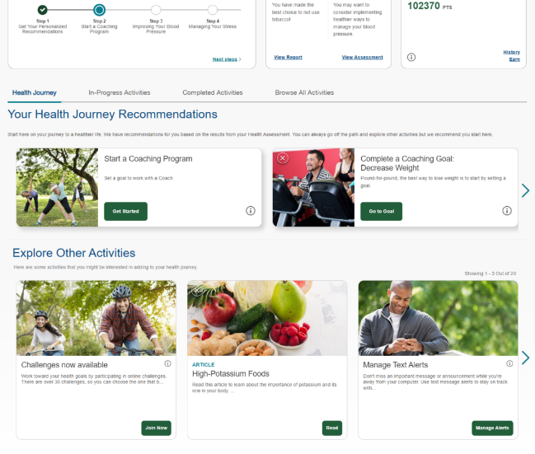
Member Wellness Portal
Portal Highlights
Health Assessment
Personalized “My Journey” member dashboard
Digital self-management programs
Trackers and tools
“Explore” wellbeing resources
Coaching program*
Interactive symptom checker
Health and wellness content
Secured messaging
Blue PointsSM *
Fitness Program
Tracking for fitness, nutrition and device integration
Personal wellness challenges
Mobile app (AlwaysOn)
Health and Wellness content
JESSICA ANGELICA
The portal includes recommended activities that make up your Personal Member Journey.
*Blue Points program rules are subject to change without prior notice. Member agrees to comply with all applicable federal, state and local laws, including making all disclosures and paying all taxes with respect to their receipt of any reward. AlwaysOn is owned and operated by Onlife Health Inc. an independent company that has contracted with Blue Cross and Blue Shield of New Mexico to provide digital health management for members with coverage through BCBSNM. BCBSNM makes no endorsement, representations or warranties regarding third-party vendors and the products and services offered by them.
May be included in other packages. The Fitness Program is provided by Tivity Health™ Services, LLC, an independent contractor which administers the Prime® Network of fitness centers. The Prime Network is made up of independently-owned and managed fitness centers. Prime is a registered trademark of Tivity Health, Inc. Tivity Health is a trademark of Tivity Health, Inc.
Screen images are for illustrative purposes only.
Notes:
Approved 06/25/25
EMI Team – Deborah Wells, Debb Bastian
Content approved by Chris Segura, Jennifer Fiske
The portal includes recommended activities that make up Member Journeys. These are actions like taking a health assessment, completing a program, or connecting a device.
Explore cards that supply dynamic, personally relevant content.
Our member wellness portal features many tools to help you become healthier. The highlights are:
Member Dashboard
This page makes it simple for you to access your health assessment, recommended programs, tools and content as it pertains to your health goals.
Health Assessment
The health assessment is available through the member dashboard page. A Personal Wellness Report that is generated from the health assessment can be accessed at any time through the portal.
Self-Management Programs
Programs are intended to provide key clinical and behavioral information that is pertinent to your wellness opportunities, tools to understand your unique internal drivers and tips for staying motivated, and the appropriate tools and resources for sustainable behavior change and long-term health promotion. There are over 20 topics available.
Trackers and Tools
Trackers are a valuable tool to track information related to the goals you have chosen.
Text Message Alerts
You can set mobile reminders such as to track your blood pressure or get 8 hours of sleep a night.
Blue Points
You can earn Blue Points for completing points-eligible activities and redeem for a variety of gift cards. Blue Points Program Rules are subject to change without prior notice. See the Program Rules on the Well onTarget Member Wellness Portal at wellontarget.com for further information. Your company may have additional reward programs in place to encourage you to take advantage of certain preventive care and wellness activities or for making healthy changes. Check your employee benefits.
Members must create a username/password for the AlwaysOn mobile app. BAM credentials can be used to log in to the web portal, but the app does not sync to BAM.

Slide 28

Our Fitness Services
Flexible and budget-friendly gym network options starting at $19 per month with Well onTarget® Fitness Program by Tivity Health™
Offered to members (and their dependents) of participating Blue Cross and Blue Shield of New Mexico plans
Unique program designed to promote health, wellness and activity for adults 18+. Family-friendly – expands gym network access to your covered dependents at a bundled price discount
Access to multiple fitness locations, nationwide where members live, work and travel. Existing and potential members can search for locations by accessing the Fitness program page through Blue Access for MembersSM and through the Well onTarget Fitness Program mobile app
Easy online enrollment (or by phone) plus fitness location finder
Member agrees to comply with all applicable federal, state and local laws, including making all disclosures and paying all taxes with respect to their receipt of any reward. The Fitness Program is provided by Tivity HealthTM, an independent contractor that administers the Prime Network of fitness locations. The Prime Network is made up of independently owned and operated fitness locations.
Blue Points Program Rules are subject to change without prior notice. See the Program Rules on the Well onTarget Member Wellness Portal at wellontarget.com for further information.
Notes:
Approved 06/25/25
EMI Team – Deborah Wells, Debb Bastian
Content approved by Chris Segura, Jennifer Fiske
Unlimited access to thousands of participating fitness locations
Different plan options to best fit member needs and preferences, including a digital-only choice

Slide 29
Flexible Gym Network
JESSICA ELLEN C
*
A choice of gym networks to fit budgets and preferences.
CLASSIC |  |  | LUXURY
Base | Core | Power | Elite | Pro | Signature | Premier
$19/mo | $29/mo | $39/mo | $129/mo | $159/mo | $199/mo | $239/mo
3,500+ Standard Gyms | 8,500+ Standard Gyms | 13,000+ Standard Gyms | Access to 1 Luxury Gym + All 13,000+ Standard Gyms (Luxury Gyms differ by tier, 180+ Available)
Digital Content: Video and Live Stream ($10/mo)
$19 enrollment fee
Membership Options to Choose From
Select a plan based on lifestyle and preferences to have access to all gyms included in the plan and lower plans.
Elite, Pro, Signature and Premier plans include the option to select a Home Gym plus access to all other gyms.
Members have the option to change their Home Gym monthly.
Family Friendly: Expands gym network access to your covered dependents at a bundled price discount. Member pays one enrollment fee for the entire family.
Convenient Payment: Monthly fees are paid via automatic credit card or bank account withdrawals.
*
Represents possible network locations. Check local listings for exact network options as some locations may not participate. Network locations are subject to change without notice.
Taxes may apply. Individuals must be at least 18 years old to purchase a membership.
Notes:
Approved 06/25/25
EMI Team – Deborah Wells, Debb Bastian
Content approved by Chris Segura, Jennifer Fiske

Slide 30
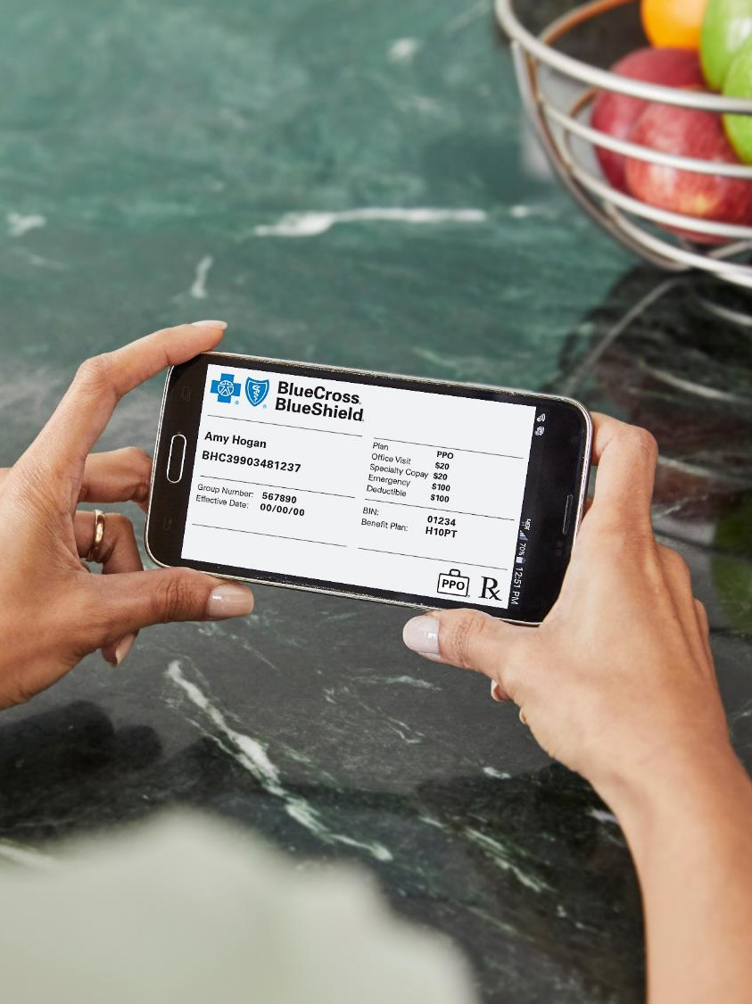
Stay Engaged in Your Health Care
JEFF K

Slide 31

How You Can Be a Smarter Consumer
JEFF K
Use in-network providers
Research costs in Provider Finder®
Review EOBs and bills sent by your providers
Use wellness benefits
See your physician regularly for preventive care or illness
Ask your health care provider questions about prescribed medications and treatment
Ask your doctor if lower-cost drug options are right for you
Visit bcbsnm.com for more health and wellness information

Slide 32
Blue Cross and Blue Shield of New Mexico
Member Customer Service for the State of New Mexico
877-994-2583

